Slide 1
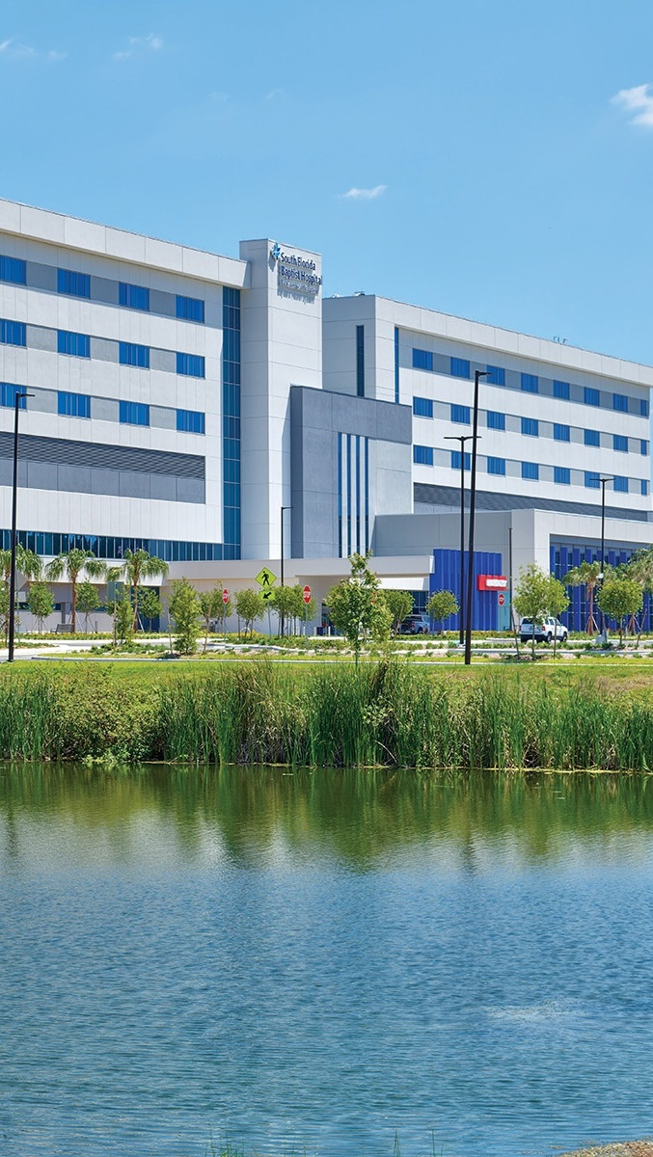


OPPORTUNITY REVIEW
DIRECT-TO-EMPLOYER GTM STRATEGY
Exploring a BayCare DTE Health Plan

Slide 2


Founded in 1979, headquartered in Indianapolis
Largest Independently-Owned Full-Service Third-Party Administrator
Specialize in Administration of Self-Funded Plans and Population Health Management​
Leader in the Direct-to-Employer Movement
We Know and Understand the Market
Experience Working with All Professional Teams: Agents, Networks, MGAs
The Key Family of Companies is a Vertically Integrated group of benefit related organizations
3,000+ Corporate Clients
3 Million Members under Management
700 Employees

Slide 3
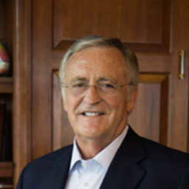


Our Founding and Heritage: 46 Years of Striving for Honesty in Healthcare

Slide 4
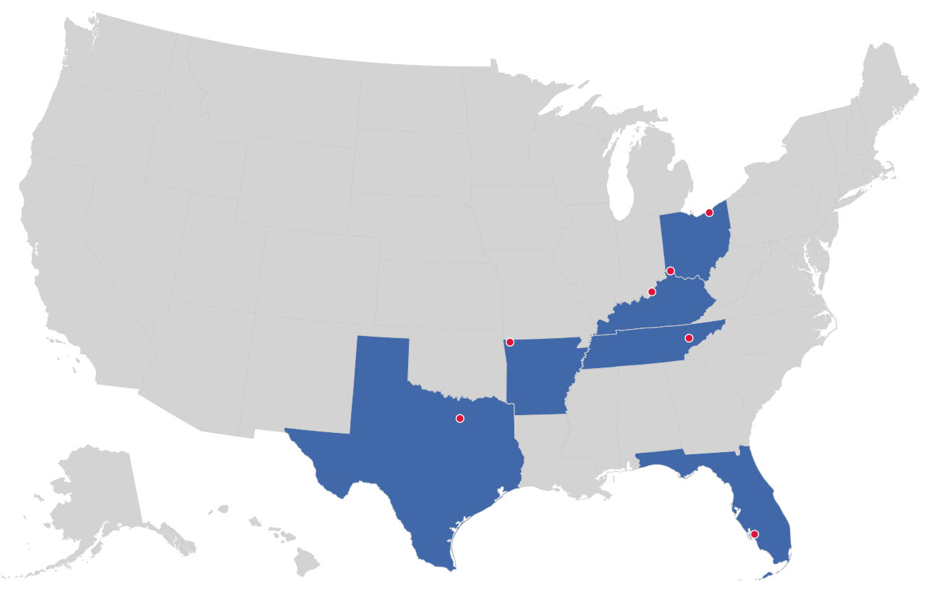

MARKET LEADER
IN
PRIVATE LABELED
DTE PLANS
Cleveland, OH
Louisville, KY
Cincinnati, OH
Bentonville, AR
Knoxville, TN
Dallas Fort Worth, TX
Fort Myers, FL

Slide 5
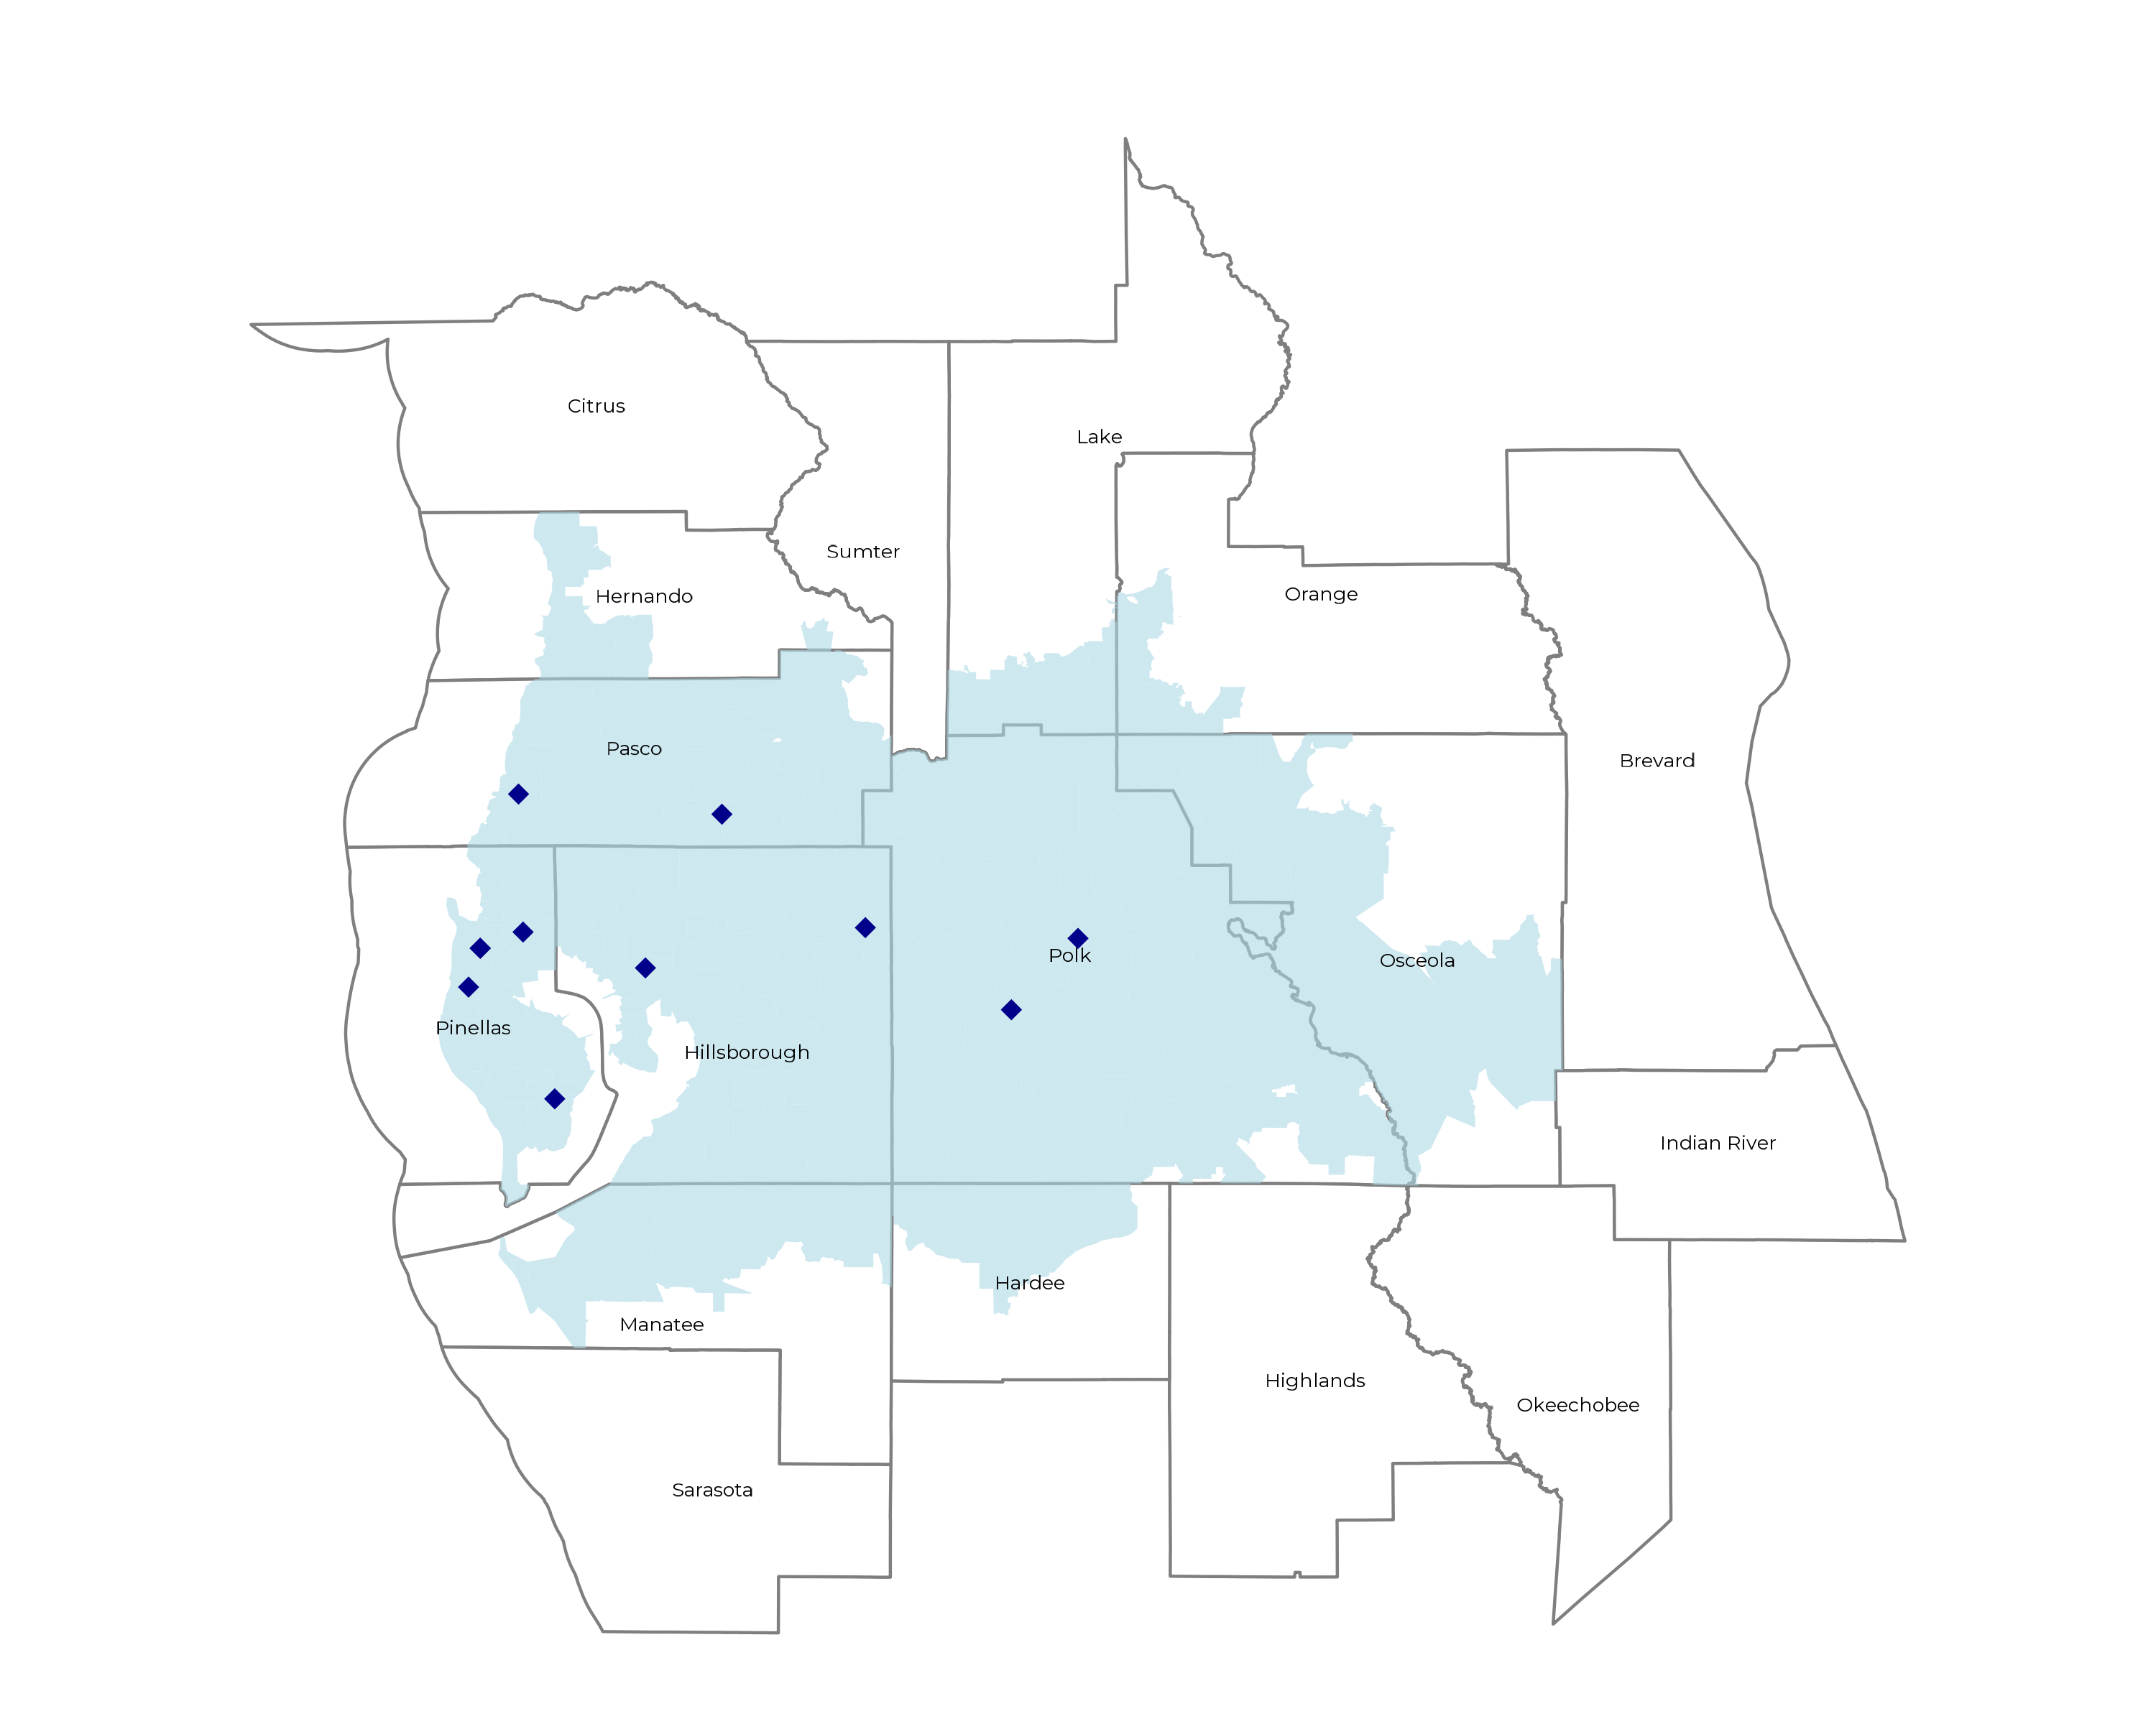
SIGNIFICANT OPPORTUNITY FOR PLAN GROWTH Researched for the below highlighted service area
Target Market 2,500+ Employers 990,000+ Employees 1,800,000+ Members
 | Employer Size Group (# of Employees)
Commercial Employers With Headquarters | 50-100 | 101-200 | 201-400 | 401-1,000 | 1,001-3,000 | 3,000+
In Catchment Area | 2,523 | 1,052 | 655 | 352 | 111 | 82
Total Employees at Employers | 50-100 | 101-200 | 201-400 | 401-1,000 | 1,001-3,000 | 3,000+
Headquartered in Catchment Area | 189,200 | 157,800 | 196,500 | 246,400 | 222,000 | 492,000
Total Members with Employers | 50-100 | 101-200 | 201-400 | 401-1,000 | 1,001-3,000 | 3,000+
Headquartered in Catchment Area | 340,600 | 284,000 | 353,700 | 443,500 | 399,600 | 885,600

Slide 6
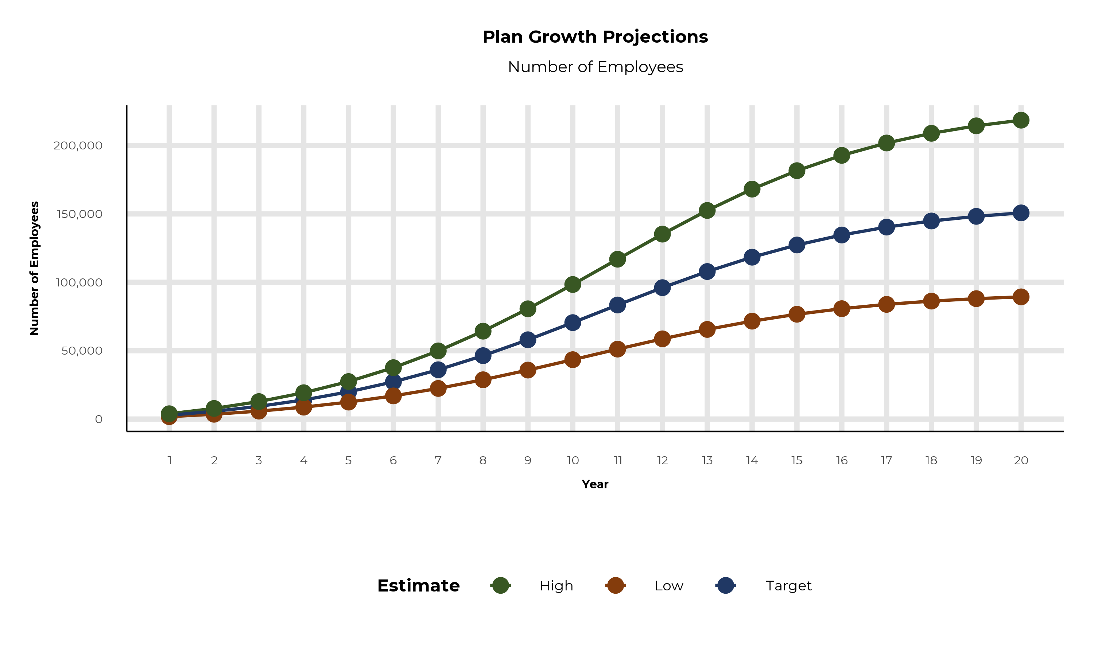
PLAN POTENTIAL GROWTH PATHS
Self Funded
1,033K
Insured
1,705K
Working Age
2,583K
Population
4,433K
Estimates includes the BayCare service area in Hardee, Hernando, Hillsborough, Lake, Manatee, Orange, Osceola, Pasco, Pinellas, and Polk Counties

Slide 7
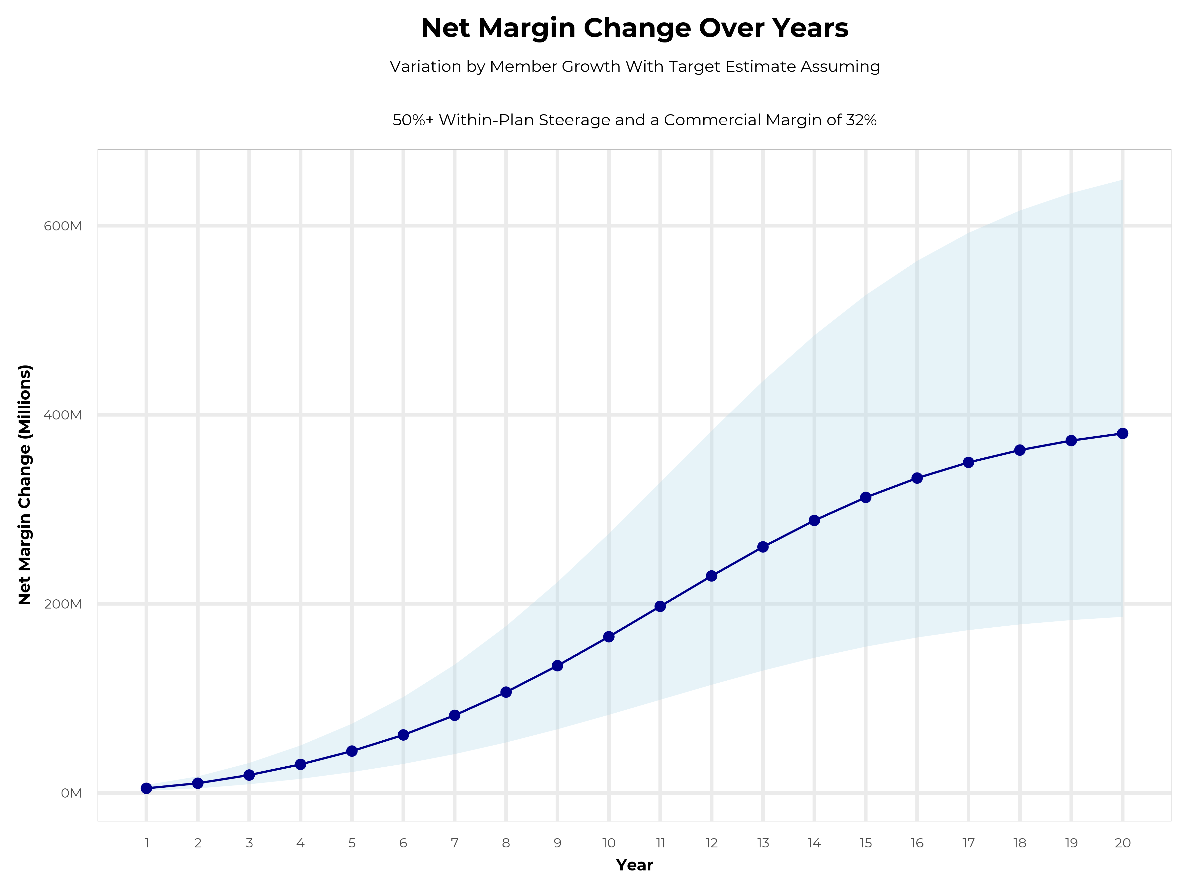
GROWING POWERFUL, LASTING PROFITABILITY
Early Stage
Gaining Name Recognition, Early Growth
New Revenue:
New Profit:
$88.08M
$28.3M
Growth Stage
Strong Reputation, Strong Growth
New Revenue:
New Profit:
$520.12M
$167.97M
Mature Stage
High Profitability, Market Saturation
New Revenue:
New Profit:
$1061.34M
$342.75M

Slide 8
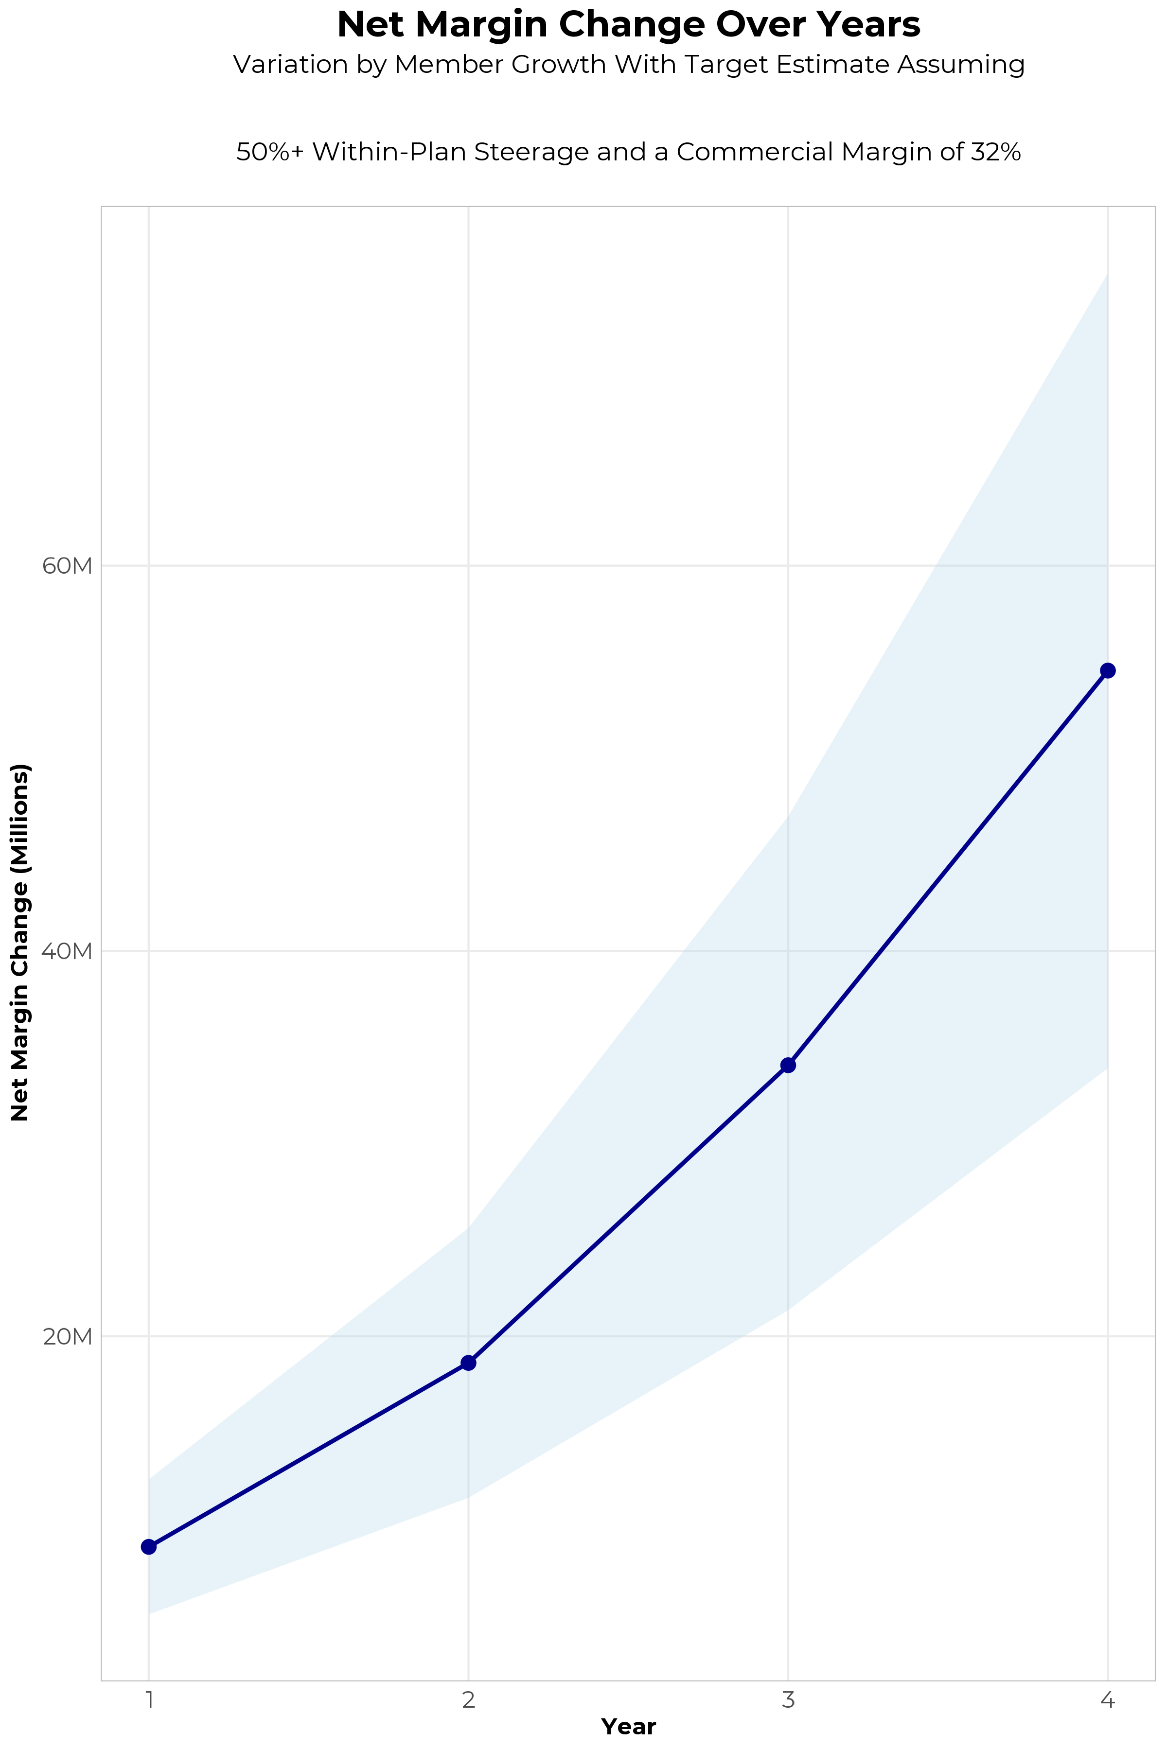
FOUR-YEAR PROJECTIONS
Target Member Growth | Target Member Growth | Target Member Growth | Target Member Growth | Target Member Growth
Metric | Year 1 | Year 2 | Year 3 | Year 4
Number of Members | 5,100 | 10,200 | 16,700 | 25,200
Incremental Margin | 9,340.9K | 18,677.7K | 34,049.2K | 54,430.5K
Network Access Fee | 61.2K | 122.4K | 200.4K | 302.4K
Implementation Fee (One-Time) | -150.0K | 0.0K | 0.0K | 0.0K
Sales and Marketing Costs | -180.0K | -180.0K | -180.0K | -180.0K
Net Margin Change | 9,072.1K | 18,620.1K | 34,069.6K | 54,552.9K
High Member Growth | High Member Growth | High Member Growth | High Member Growth | High Member Growth
Metric | Year 1 | Year 2 | Year 3 | Year 4
Number of Members | 7,000 | 14,000 | 23,000 | 34,700
Incremental Margin | 12,820.8K | 25,636.0K | 46,894.0K | 74,949.9K
Network Access Fee | 84.0K | 168.0K | 276.0K | 416.4K
Implementation Fee (One-Time) | -150.0K | 0.0K | 0.0K | 0.0K
Sales and Marketing Costs | -180.0K | -180.0K | -180.0K | -180.0K
Net Margin Change | 12,574.8K | 25,624.0K | 46,990.0K | 75,186.3K
Low Member Growth | Low Member Growth | Low Member Growth | Low Member Growth | Low Member Growth
Metric | Year 1 | Year 2 | Year 3 | Year 4
Number of Members | 3,200 | 6,400 | 10,500 | 15,700
Incremental Margin | 5,860.9K | 11,719.3K | 21,408.1K | 33,911.0K
Network Access Fee | 38.4K | 76.8K | 126.0K | 188.4K
Implementation Fee (One-Time) | -150.0K | 0.0K | 0.0K | 0.0K
Sales and Marketing Costs | -180.0K | -180.0K | -180.0K | -180.0K
Net Margin Change | 5,569.3K | 11,616.1K | 21,354.1K | 33,919.4K

Slide 9

DIRECT-TO-EMPLOYER STRATEGY: ONLY AVAILABLE TO PREMIER HEALTH SYSTEMS
STRONG Brand Quality
EXTENSIVE Patient Access
AFFORDABLE Value Pricing
EXCELLENT Care Quality

Slide 10
BAYCARE IS PATIENT RECOMMENDED
Health System | HCAHPS Recommendation Percentile | CMS Stars Percentile | Mortality Percentile | Readmission Percentile | KBA Brand Quality Score
BayCare Health System | 75 | 75 | 77 | 61 | 71
Tampa General Hospital | 51 | 26 | 64 | 51 | 62
AdventHealth | 45 | 67 | 68 | 62 | 61
Orlando Health | 44 | 48 | 74 | 53 | 61
Lakeland Regional Health Medical Center | 33 | 8 | 69 | 35 | 55
HCA Healthcare | 20 | 31 | 78 | 47 | 50
Universal Health Services | 20 | 48 | 83 | 64 | 50
Based on quality measures and HCAHPS feedback, KBA estimates that BayCare has the strongest brand quality in Hardee, Hernando, Hillsborough, Lake, Manatee, Orange, Osceola, Pasco, Pinellas, and Polk Counties.

Slide 11
The Key Incentive Plan
Base Medical + Preferred Plus Benefits = Your Deductible Can Simply Vanish
Example: Member with a $2,500 deductible / $4,500 max out-of-pocket has a heart attack and cardiac surgery, resulting in a 5-day in-patient stay. In this example, the member would have a $4,500 OOP with $5,050 Preferred Plus Benefits for a net OOP $0 due to the preferred provider versus $4,500 OOP exposure at any non-preferred provider.
BASE MEDICAL BENEFITS* |  |  | PREFERRED PLUS BENEFITS
Deductible |  |  | Benefits automatically included in your plan!
Single | $2,500 |  |  | Preferred Provider | Non-Preferred Provider
Family | $4,500 |  | OP Radiology/X-Ray | $200 | $0
Coinsurance |  |  | OP Diagnostic Labs | $100 | $0
80% / 20% |  |  | Preferred Hospital Stay ($500/day, 5 days) | $2,500 | $0
Maximum Out-of-Pocket |  |  | Critical Illness Benefit | $2,000 | $0
Single | $4,500 |  | Health Screening Benefit | $125 | $0
Family | $9,000 |  | Total Employee OOP | $4,500 | $4,500
Chronic Disease Management Regimens of Care Covered at 100% |  |  | Preferred Plus Benefits | $4,925 | $0
Healthcare Convience Card to Cover Out-of-Pocket Expenses at 0% interest |  |  | Employee Amount Due to Provider | $0 | $4,500
Health Guardian Account to help members manage their healthcare expenses at Preferred Providers |  |  | Additional Benefit Payable to the Health Guardian Account | $425 | $0
*Base Medical Benefits are for illustration purposes only. Base benefits can be customized to meet client needs.

Slide 12

THE BENEFIT STEERING THE PATIENT TO BAYCARE
What Will this Claim Cost Me?
Explanation of Benefits
Heart Attack, Cardiac Surgery
THE CHARGES
Medical Bills | $25,000
Healthcare out-of-pocket due to provider | $4,500
Since your out of pocket maximum has been met, the rest of your eligible charges this year will be paid at 100%
THE CREDITS
OP Radiology/X-Ray | $200
OP Diagnostic Labs | $100
Preferred Hospital Stay ($500/day, 5 days) | $2,500
Critical Illness Benefit | $2,000
Health Screening Benefit | $125
Benefit Total | $4,925
Out of Pocket Paid to Hospital | ($4,500)
Balance Paid to HSA | $425
BayCare patients can have all out-of-pocket liability reduced to $0!

Slide 13

THE KBA HEALTHCARE CONVENIENCE CARD
Creating EPO Steerage in a PPO Network
The Healthcare Convenience Card is eligible to be used only for specific merchant codes.
To utilize at Specific Healthcare Providers
a. Designated Hospitals
b. Urgent Care Facilities
c. Physicians
d. Eligible Ancillary Providers
Out of Pocket Expenses Qualify
0% Interest Rate
Employee Determines Repayment Schedules
5. To Qualify: Answer One Simple Question

Slide 14

FINANCIAL PROJECTIONS
& ASSUMPTIONS

Slide 15
PROJECTED PLAN GROWTH
Year | Employees | Members | Percent of Members Choosing BayCare for Inpatient Care | Percent of Members Choosing BayCare for Outpatient Care
1 | 2,800 | 5,000 | 60% | 50%
2 | 5,600 | 10,100 | 60% | 50%
3 | 9,300 | 16,700 | 65% | 55%
4 | 14,000 | 25,200 | 67% | 58%
5 | 19,900 | 35,800 | 68% | 60%
6 | 27,200 | 49,000 | 68% | 60%
7 | 36,000 | 64,800 | 69% | 61%
8 | 46,400 | 83,500 | 69% | 62%
9 | 58,000 | 104,400 | 69% | 62%
10 | 70,500 | 126,900 | 70% | 63%
11 | 83,400 | 150,100 | 70% | 63%
12 | 96,100 | 173,000 | 70% | 64%
13 | 107,900 | 194,200 | 71% | 64%
14 | 118,300 | 212,900 | 71% | 65%
15 | 127,300 | 229,100 | 71% | 66%
16 | 134,600 | 242,300 | 72% | 66%
17 | 140,300 | 252,500 | 72% | 66%
18 | 144,800 | 260,600 | 72% | 67%
19 | 148,200 | 266,800 | 72% | 67%
20 | 150,700 | 271,300 | 72% | 67%
KBA currently estimates that BayCare has 15% inpatient market share, and 8% outpatient market compared to hospitals/clinics in the BayCare service area (see slide 8).
Based on previous DTE experience, KBA expects a significant bump in patient steerage to BayCare.
Additional steerage will occur from additional steerage patient benefits and the patient convenience card.
High estimates start nearly 10% higher than target with low estimates at 10% lower than target

Slide 16
YEAR 4 PROJECTED REVENUE AND PROFIT
Pre-DTE Cohort of 25,200 Employees | Inpatient | Outpatient | Professional | Total
Revenue† | $ 14,013,679 | $ 13,653,853 | $ 6,376,233 | $ 34,043,765
Net Income‡ | $ 4,484,377 | $ 4,369,233 | $ 2,040,395 | $ 10,894,005
† Assuming proportional revenues from market shares of 15% (inpatient) and 8% (outpatient)
‡ Conservatively assuming a commercial margin of 32% (80% of the estimated commercial margin)
With DTE | Inpatient | Outpatient | Professional | Total
Revenue⁰ | $ 61,564,416 | $ 96,544,193 | $ 45,085,317 | $ 203,193,927
Net Income* | $ 19,700,613 | $ 30,894,142 | $ 14,427,302 | $ 65,022,057
⁰ Assuming 67% inpatient and 58% market steerage based on KBA narrow network DTE experience (see previous slide)
* Conservatively assuming a commercial margin of 32%, with a 10 percentage-point reduction to reflect competitive-edge rates and a 10 percentage-point increase due to lower billing costs and higher patient responsibility collections because of the member convenience card.
Total Increase in Net Income | $ 54,128,052
Network Access Fee (Revenue) of $1 PMPM | $ 302,400
Total Profit Growth | $ 54,430,452
Minus Implementation Fee (One-Time) | -$ 0
Minus Sales and Marketing (Annual – Ongoing) | -$ 180,000
Total | $ 54,250,452

Slide 17





A PARTNER YOU CAN TRUST
OUR OBJECTIVES ARE ALIGNED
WE KNOW THE
MARKET
COMPLETELY TRANSPARENT
WE HAVE THE SOPHISTICATION AND INFRASTRUCTURE TO EFFECTIVELY COMPETE
Derek Moore, Senior Vice President – KBA
845-283-9973 * derek.moore@keybenefit.com

